Slide 1
2023 Summer Math Class I

Slide 2
Topic
Introduce GitHub: Create an account in https://github.com/STEMEduX, and login the account, be able to navigate to the folders for the Math class.
Calculation: 50 problems, 5 minutes. Focusing on speed and calculation accuracy

Slide 3
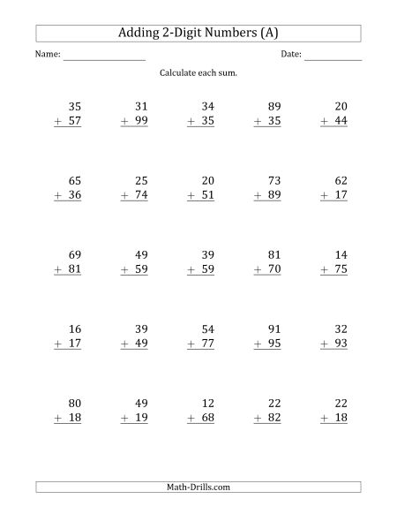

Slide 4
Rounding 1: When w multiplying numbers that are easily rounded up such as ending 8 or 9, use the subtraction method. For example, 49 x 16

Slide 5
Rounding 2: For some subtractions, do additions first then subtract. For example, 632 – 478:

Slide 6
Rounding 3: For some additions, do rounding first. For example 76 + 81:

Slide 7
Squaring double-digit numbers ending in 5: For example, x5

Slide 8
For two digit number multiplications, if the tenth digits are the same and the sum of the unit digits equals to 10, then xy * xz = x * (x + 1) * 100 + y * z:
  82 * 88 = 8 * 9 * 100 + 2 * 8 = 7216

Slide 9
Multiplying by 11:
  42 x 11 = 400 + (4 + 2) x 10 + 2 =462
  89 x 11 = 800 + (8 + 9) x 10 + 9 = 979

